Slide 1
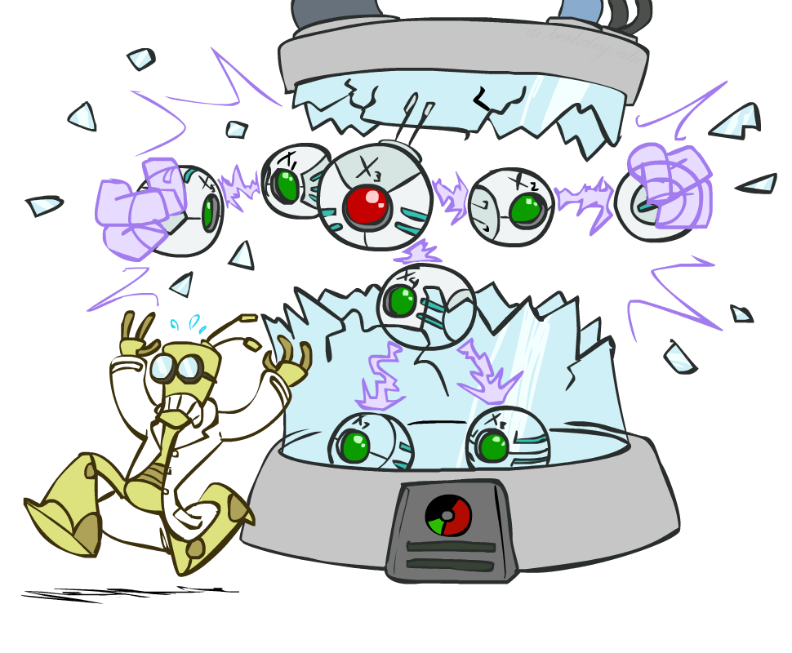
贝叶斯网络: 独立性(independence)

Slide 2
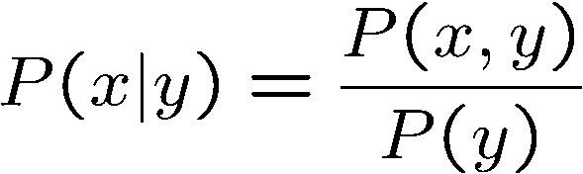

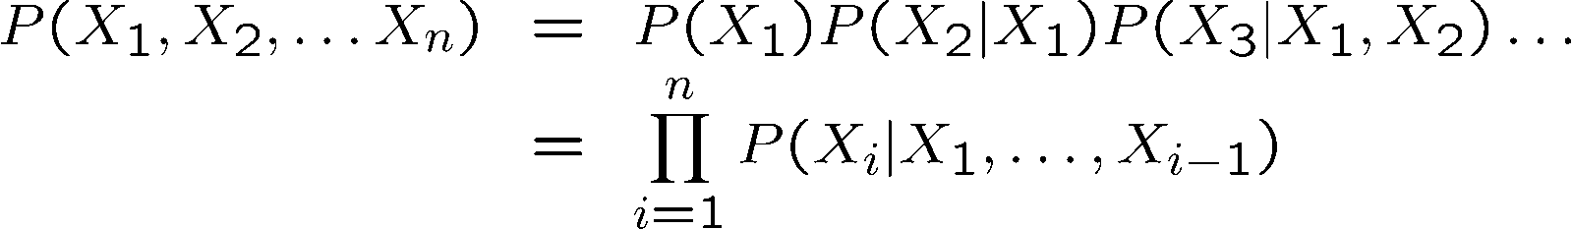

概率复习
Conditional probability
Product rule
Chain rule
X, Y independent if and only if:
X and Y are conditionally independent given Z if and only if:

Slide 3
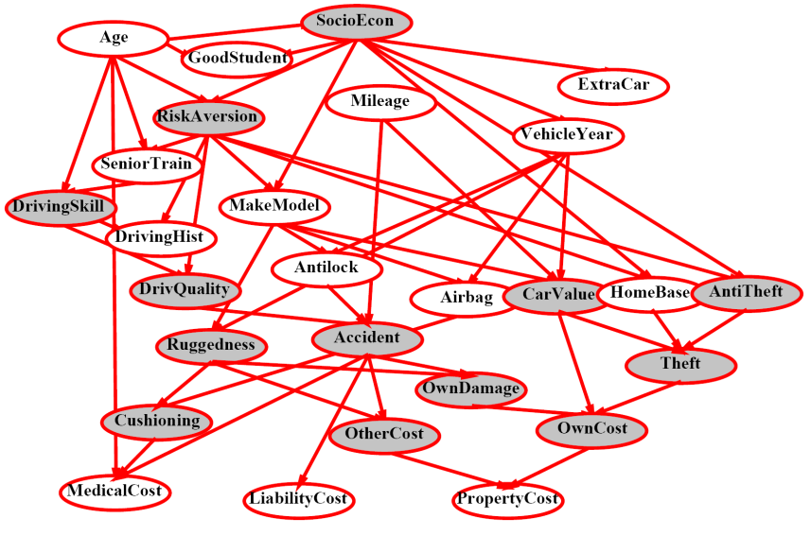
Bayes’ Nets 贝叶斯网络
对一个领域里变量构成的概率模型的
有效率的编码
Questions we can ask:
推理: given a fixed BN, what is P(X | e)?
表达: given a BN graph, what kinds of distributions can it encode?
建模: what BN is most appropriate for a given domain?
Notes:
Independence assumptions are related to BNs’ graph structure.

Slide 4
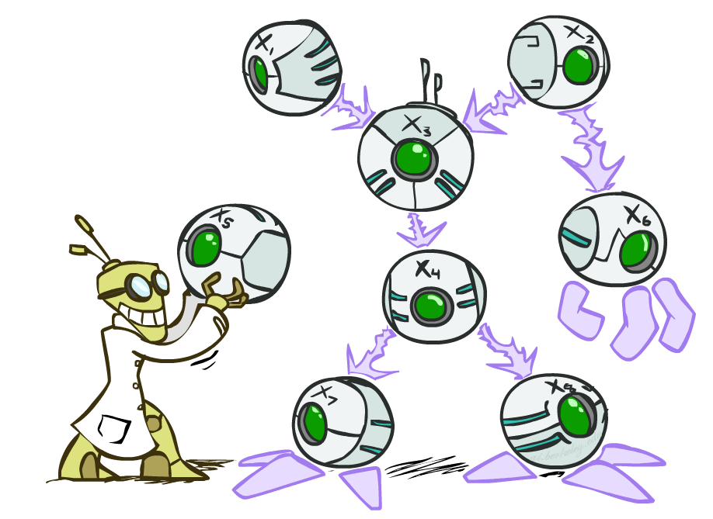

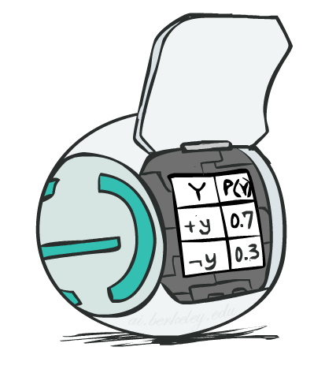
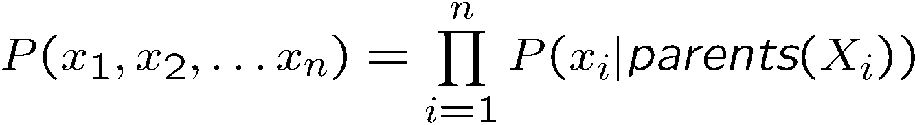
贝叶斯网络的语义
A directed, acyclic graph, one node per random variable
A conditional probability table (CPT) for each node
A collection of distributions over X, one for each combination of parents’ values
Bayes’ nets implicitly encode joint distributions
As a product of local conditional distributions
To see what probability a BN gives to a full assignment, multiply all the relevant conditionals together:

Slide 5
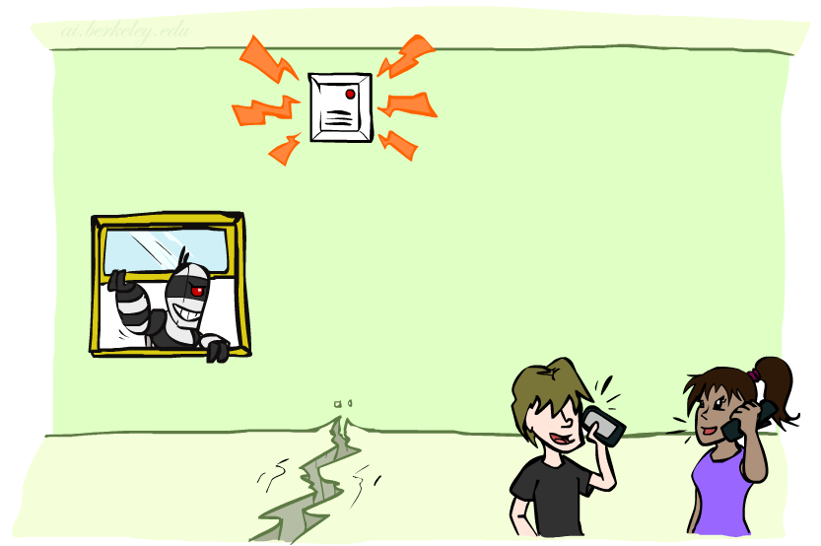

Example: Alarm Network
B | P(B)
+b | 0.001
-b | 0.999
B
E
E | P(E)
+e | 0.002
-e | 0.998
A
A | J | P(J|A)
+a | +j | 0.9
+a | -j | 0.1
-a | +j | 0.05
-a | -j | 0.95
A | M | P(M|A)
+a | +m | 0.7
+a | -m | 0.3
-a | +m | 0.01
-a | -m | 0.99
B | E | A | P(A|B,E)
+b | +e | +a | 0.95
+b | +e | -a | 0.05
+b | -e | +a | 0.94
+b | -e | -a | 0.06
-b | +e | +a | 0.29
-b | +e | -a | 0.71
-b | -e | +a | 0.001
-b | -e | -a | 0.999
J
M
Notes:
demo

Slide 6

Example: Alarm Network
B | P(B)
+b | 0.001
-b | 0.999
B
E
E | P(E)
+e | 0.002
-e | 0.998
A
A | J | P(J|A)
+a | +j | 0.9
+a | -j | 0.1
-a | +j | 0.05
-a | -j | 0.95
A | M | P(M|A)
+a | +m | 0.7
+a | -m | 0.3
-a | +m | 0.01
-a | -m | 0.99
B | E | A | P(A|B,E)
+b | +e | +a | 0.95
+b | +e | -a | 0.05
+b | -e | +a | 0.94
+b | -e | -a | 0.06
-b | +e | +a | 0.29
-b | +e | -a | 0.71
-b | -e | +a | 0.001
-b | -e | -a | 0.999
J
M
Notes:
demo

Slide 7

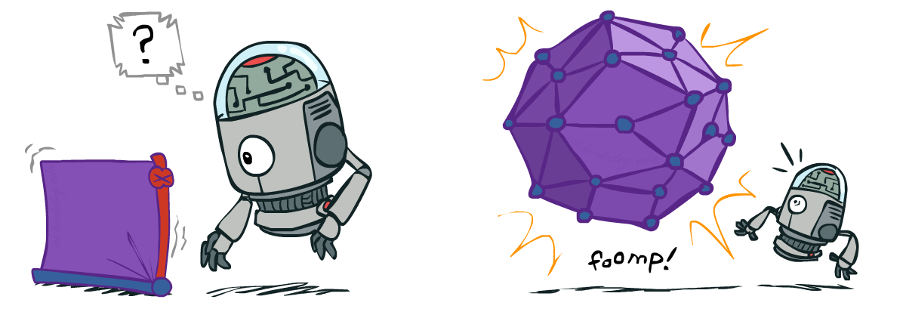
Size of a Bayes’ Net
How big is a joint distribution over N Boolean variables?
2^{N}
How big is an N-node net if nodes have up to k parents?
O(N * 2^{k+1})
Both give you the power to calculate
BNs: Huge space savings!
Also easier to elicit local CPTs
Also faster to answer queries (coming)

Slide 8

Bayes’ Nets
Representation
Conditional Independences
Probabilistic Inference
Learning Bayes’ Nets from Data

Slide 9

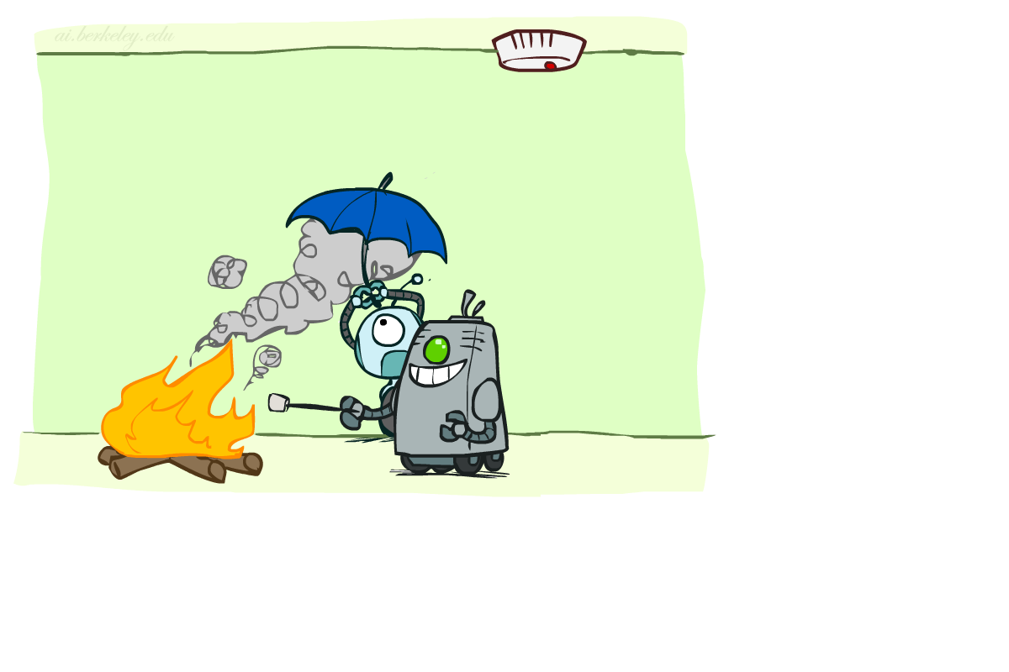

Conditional Independence 条件独立性
X and Y are independent if
X and Y are conditionally independent given Z
(Conditional) independence is a property of a distribution
Example:

Slide 10
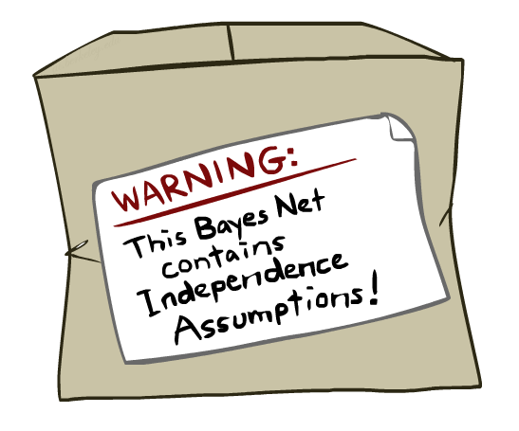
Bayes Nets: Assumptions
Assumptions we are required to make to define the Bayes net when given the graph:
Beyond above “chain rule → Bayes net” conditional independence assumptions
Often additional conditional independences
They can be read off the graph
Important for modeling: understand assumptions made when choosing a Bayes net graph
Notes:
Important for modeling: understanding which assumptions you are making!

Slide 11
条件独立性语义
当给定它的父节点取值后，每个变量都是条件独立于它的其他祖先节点变量
Notes:
祖先节点这里应指父节点的父节点，依次类推。

Slide 12
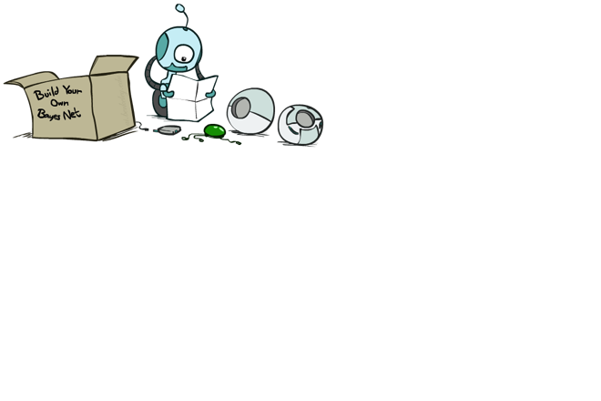
贝叶斯网络里的概率
为什么我们可以保证以下公式是正确的联合分布
P(X₁,..,X_{n}) = ∏_{i} P(X_{i} | Parents(X_{i}))
连锁法 (对所有分布有效): P(X₁,..,X_{n}) = ∏_{i} P(X_{i} | X₁,…,X_{i-1})
假定 条件独立性: P(X_{i} | X₁,…,X_{i-1}) = P(X_{i} | Parents(X_{i}))
当加入节点 X_{i}, 确保其父节点 “屏蔽” 它与其他祖先节点的联系
给定它的父节点，每个变量条件独立于它的非子孙节点变量(即所有它之前的变量)
→ 结果: P(X₁,..,X_{n}) = ∏_{i} P(X_{i} | Parents(X_{i}))
所以，网络的拓扑结构暗示着条件独立性

Slide 13
Example
X
Y
Z
W
蕴含哪些条件独立性假设 （directly from simplifications in chain rule ）？
还有没有蕴含其他的条件独立性假设?

Slide 14
Independence in a BN
Important question about a BN:
Are two nodes independent given certain evidence?
If yes, can prove using algebra (tedious in general)
If no, can prove with a counter example
Example:
Question: are X and Z necessarily independent?
Answer: no. Example: low pressure causes rain, which causes traffic.
X can influence Z, Z can influence X (via Y)
Addendum: they could be independent: how?
X
Y
Z

Slide 15
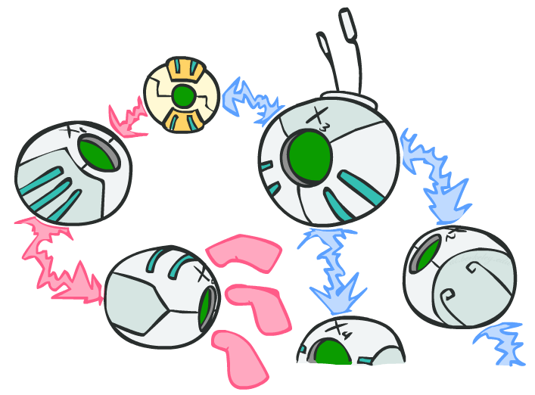
D-separation(D分离): Outline

Slide 16
D-separation: Outline
Study independence properties for triples
Analyze complex cases in terms of member triples
D-separation: a condition / algorithm for answering such queries

Slide 17
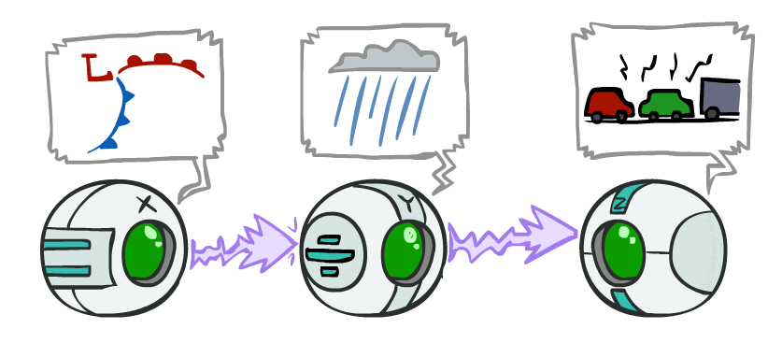
Causal Chains （因果关系链）
This configuration is a “causal chain”
Guaranteed X independent of Z ? No!
One example set of CPTs for which X is not independent of Z is sufficient to show this independence is not guaranteed.
Example:
Low pressure causes rain causes traffic,
high pressure causes no rain causes no
traffic
In numbers:
P( +y | +x ) = 1, P( -y | - x ) = 1,
P( +z | +y ) = 1, P( -z | -y ) = 1
X: Low pressure Y: Rain Z: Traffic

Slide 18
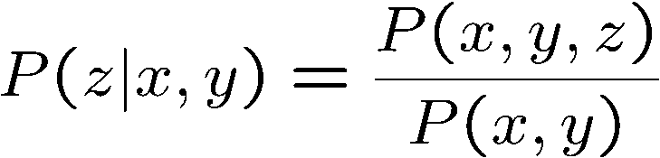
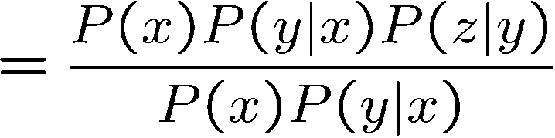

Causal Chains （因果关系链）
This configuration is a “causal chain”
Guaranteed X independent of Z given Y?
Evidence along the chain “blocks” the influence
X: Low pressure Y: Rain Z: Traffic
Yes!

Slide 19
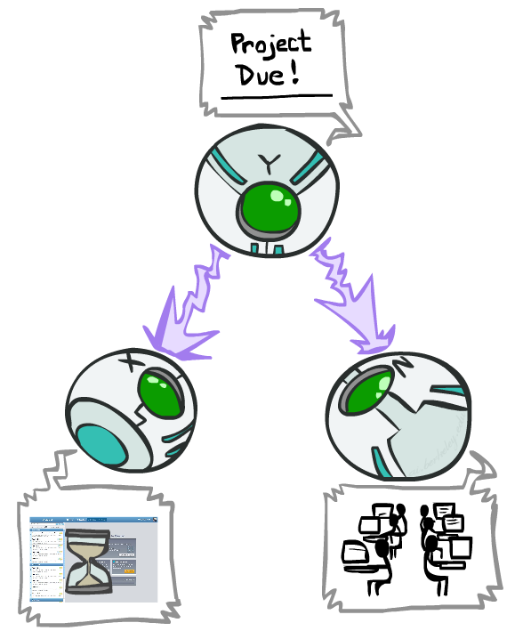
Common Cause（原因相同）
This configuration is a “common cause”
Guaranteed X independent of Z ? No!
One example set of CPTs for which X is not independent of Z is sufficient to show this independence is not guaranteed.
Example:
Project due causes both forums busy
and lab full
In numbers:
P( +x | +y ) = 1, P( -x | -y ) = 1,
P( +z | +y ) = 1, P( -z | -y ) = 1
Y: Project due
X: Forums busy
Z: Lab full

Slide 20
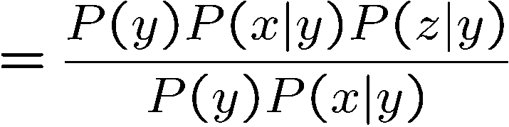
Common Cause （原因相同）
This configuration is a “common cause”
Guaranteed X and Z independent given Y?
Observing the cause blocks influence between effects.
Y: Project due
X: Forums busy
Z: Lab full
Yes!
Notes:
Joint probability was formed according to the structure of the graph.

Slide 21
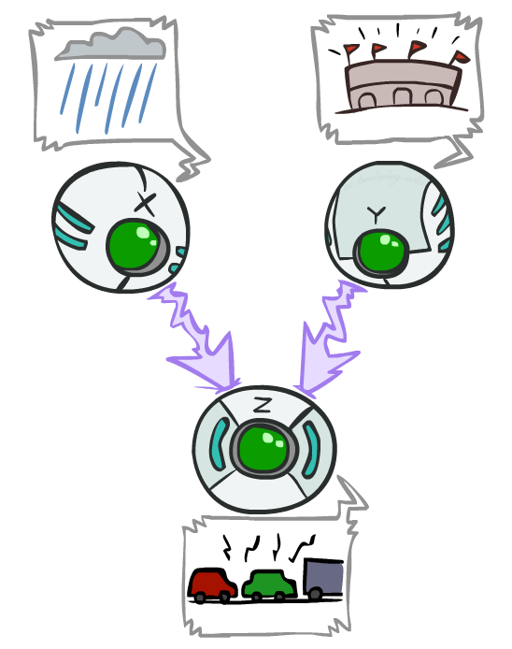
Common Effect （结果相同）
Last configuration: two causes of one effect (v-structures)
Are X and Y independent?
Yes: the ballgame and the rain cause traffic, but they are not correlated
Still need to prove they must be (try it!)
Are X and Y independent given Z?
No: seeing traffic puts the rain and the ballgame in competition as explanation.
This is backwards from the other cases
Observing an effect activates influence between possible causes.
X: Raining
Y: Ballgame
Z: Traffic

Slide 22

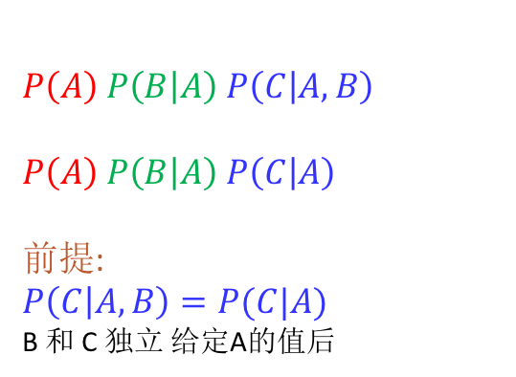
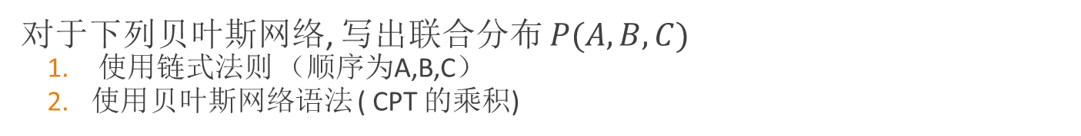

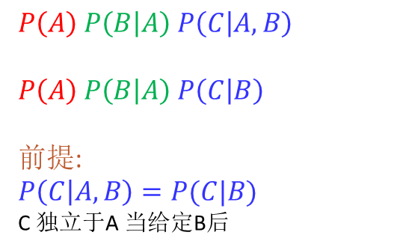






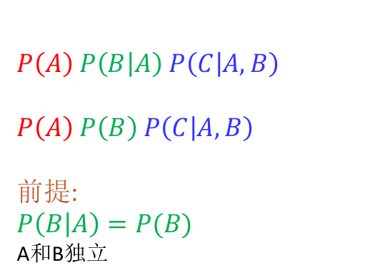
条件独立语法
对于下列贝叶斯网络, 写出联合分布 $P(A,B,C)$
使用链式法则 （顺序为A,B,C）
使用贝叶斯网络语法 ( CPT 的乘积)
$$A$$
$$A$$
$$B$$
$$A$$
$$B$$
$$C$$
$$B$$
$$C$$
$$C$$
$$P\left(A\right) P\left(B | A\right) P\left(C | A,B\right)$$
$$P\left(A\right) P\left(B | A\right) P\left(C | B\right)$$
前提:
$$P\left(C | A,B\right)=P(C|B)$$
C 独立于A 当给定B后
$$P\left(A\right) P\left(B | A\right) P\left(C | A,B\right)$$
$$P\left(A\right) P\left(B | A\right) P\left(C | A\right)$$
前提:
$$P\left(C | A,B\right)=P(C|A)$$
B 和 C 独立 给定A的值后
$$P\left(A\right) P\left(B | A\right) P\left(C | A,B\right)$$
$$P\left(A\right) P\left(B\right) P\left(C | A, B\right)$$
前提:
$$P\left(B | A\right)=P(B)$$
A和B独立
Notes:
第三个结构，当给定C的值后A和B就不是独立了。

Slide 23
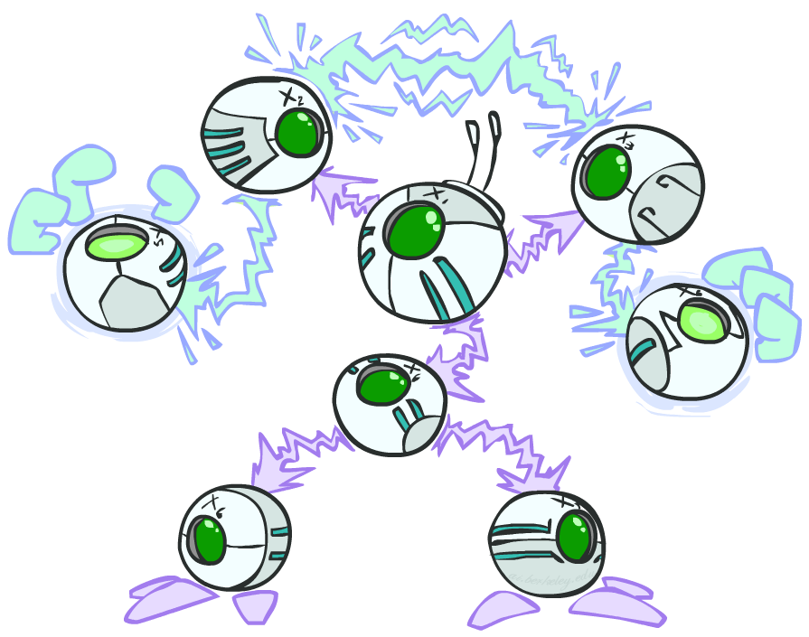
The General Case(一般情况)
General question: in a given BN, are two variables independent (given evidence)?
Solution: analyze the graph
Any complex example can be broken
into repetitions of the three canonical cases

Slide 24

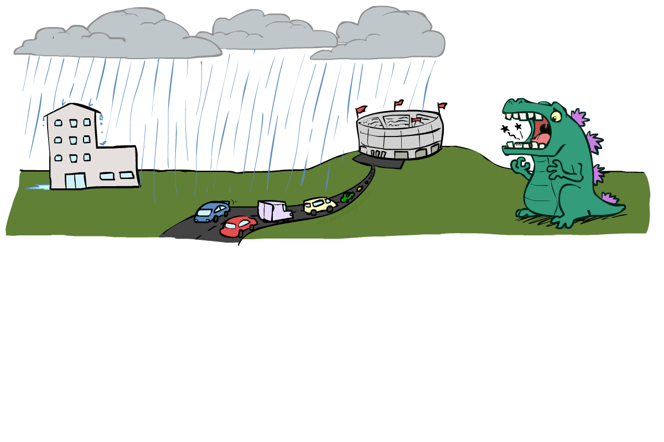
Reachability（联通性判断是否条件独立）
L
Recipe: shade evidence nodes, look for paths in the resulting graph
Attempt 1: if two nodes are connected by an undirected path blocked by a shaded node, they are conditionally independent
Almost works, but not quite
Where does it break?
Answer: the v-structure at T doesn’t count as a link in a path unless “active”
R
B
D
T

Slide 25
Active / Inactive Paths
Question: Are X and Y conditionally independent given evidence variables {Z}?
Yes, if X and Y “d-separated” by Z
Consider all (undirected) paths from X to Y
No active paths = independence!
A path is 通路 if each triple is active:
Causal chain A → B → C where B is unobserved (either direction)
Common cause A ← B → C where B is unobserved
Common effect (aka v-structure)
A → B ← C where B or one of its descendents is observed
All it takes to block a path is a single inactive segment
Active Triples
Inactive Triples

Slide 26
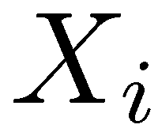
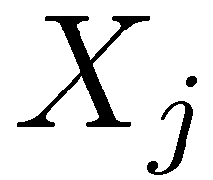

D-Separation （D分离）
?
Query:
Check all (undirected!) paths between and
If one or more active, then independence not guaranteed
Otherwise (i.e. if all paths are inactive),
then independence is guaranteed

Slide 27


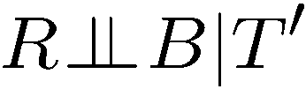
Example
Yes
R
B
T
T’
Notes:
T’: traffic report
No,
No.

Slide 28
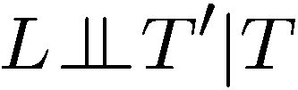


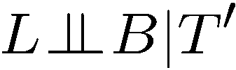

Example
L
Yes
R
B
Yes
D
T
Yes
T’

Slide 29



Example
Variables:
R: Raining
T: Traffic
D: Roof drips
S: I’m sad
Questions:
R
T
D
S
Yes

Slide 30

图形结构蕴含了条件独立假设
给定一个贝叶斯网络结构, 可以运行 d-separation 算法，找到所有条件独立假设：
This list determines the set of probability distributions that can be represented
Notes:
这种条件假设是不管分布表中实际放的是什么值。

Slide 31
尝试计算所有表达的独立性假设
Y
X
Z
Y
X
Z
X
Z
Y
Y
X
Z
Notes:
Last one doesn’t have any (conditional) independences.

Slide 32
图结构限制了所能表达的分布集合
Given some graph topology G, only certain joint distributions can be encoded
图结构保证了（条件）独立假设的存在
(There might be more independence)
增加边，扩大了所能表示的分布集合, but has several costs
Full conditioning can encode any distribution
Y
Y
X
Z
X
Z
Y
X
Z
Y
X
Z
Y
Y
Y
X
Z
X
Z
X
Z
Y
Y
Y
X
Z
X
Z
X
Z
Notes:
{} ： denotes assumption set.
When add an edge, you remove an assumption. When remove an edge, you add an assumption.

Slide 33
贝叶斯网络表达语义小结
贝叶斯网络 compactly encode 联合分布
从贝叶斯网络图的结构可以推出独立性假设
D-separation gives precise 条件独立性假设 from graph alone
一个贝叶斯网络所表达的联合分布模型中可能还存在（D分离）监测不出来的 (条件) 独立情况，除非这时你检查具体的分布中的数值（来做进一步的推断）

Slide 34
贝叶斯网络内容
Representation
Conditional Independences
Probabilistic Inference
Enumeration (exact, exponential complexity)
Variable elimination (exact, worst-case
exponential complexity, often better)
Probabilistic inference is NP-complete
Sampling (approximate)
Learning Bayes’ Nets from Data

